Slide 1
Assignment 2:
POVs, HMWs, and Prototype Analysis
Our Music Playlists
Additional Interviews
Brainstorm
Experience Prototypes
Casey Nguyen, Kayla Patterson, Caroline Tran, Sophie Wu
Notes:
Good morning everyone! Today, we’ll be talking about our findings from our additional interviews, our brainstorming process, our prototypes, and finally, the solution we decided to move forward with.

Slide 2
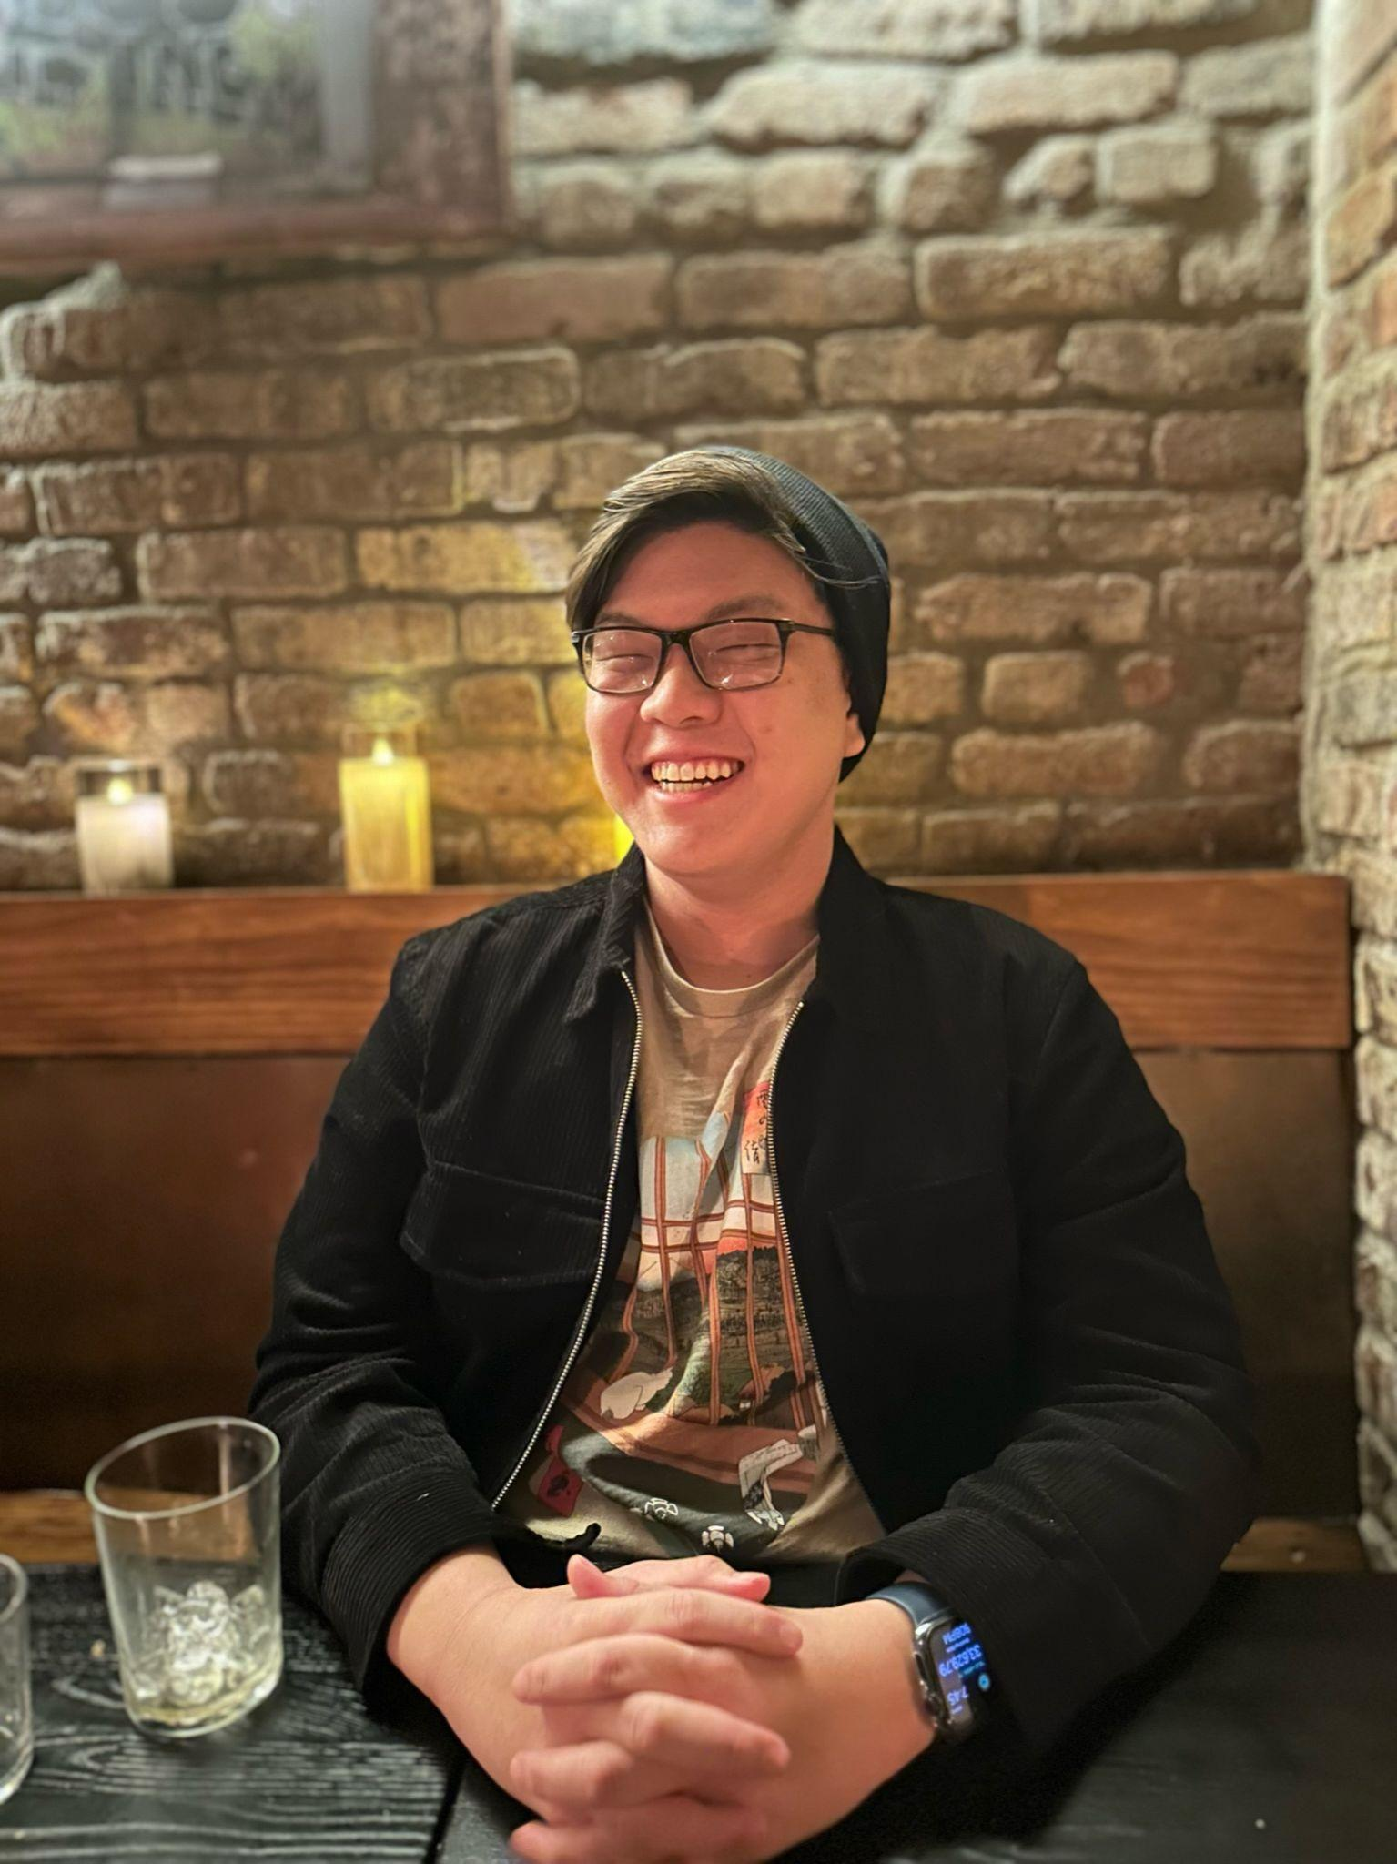
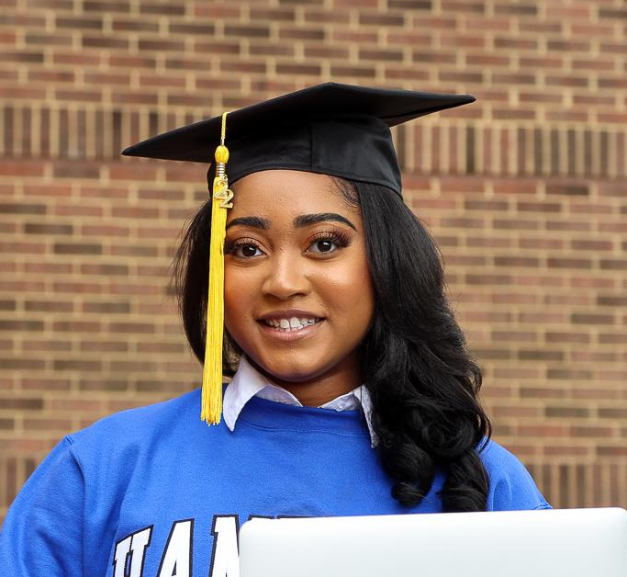
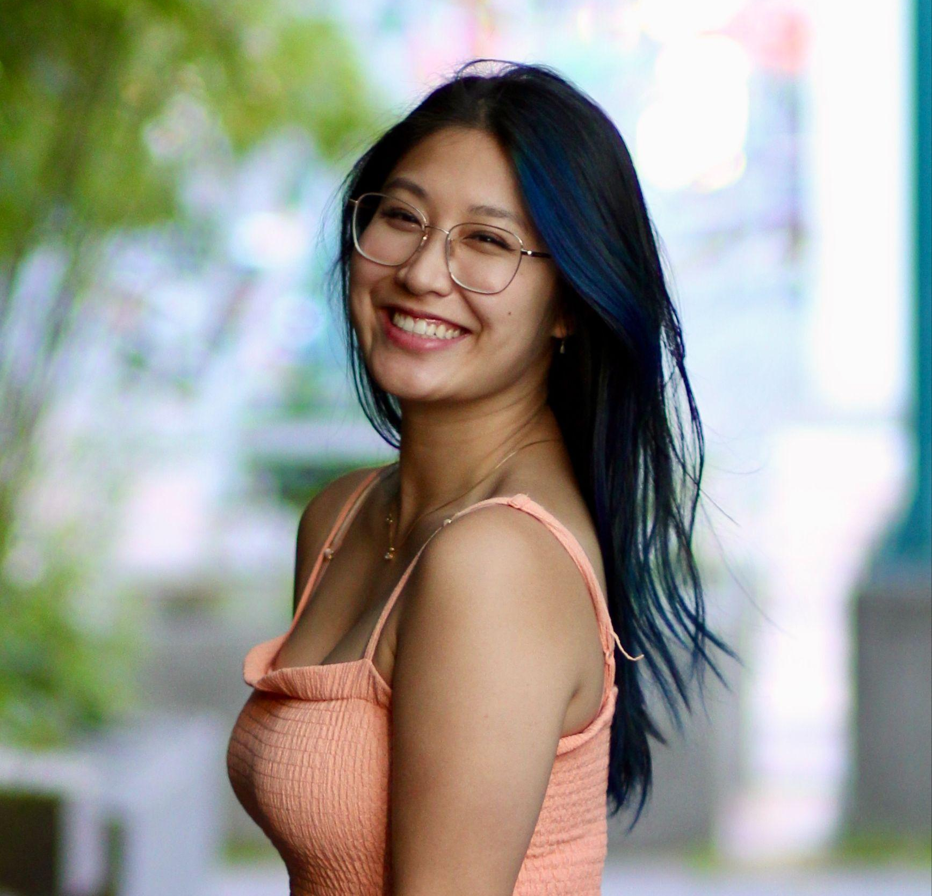
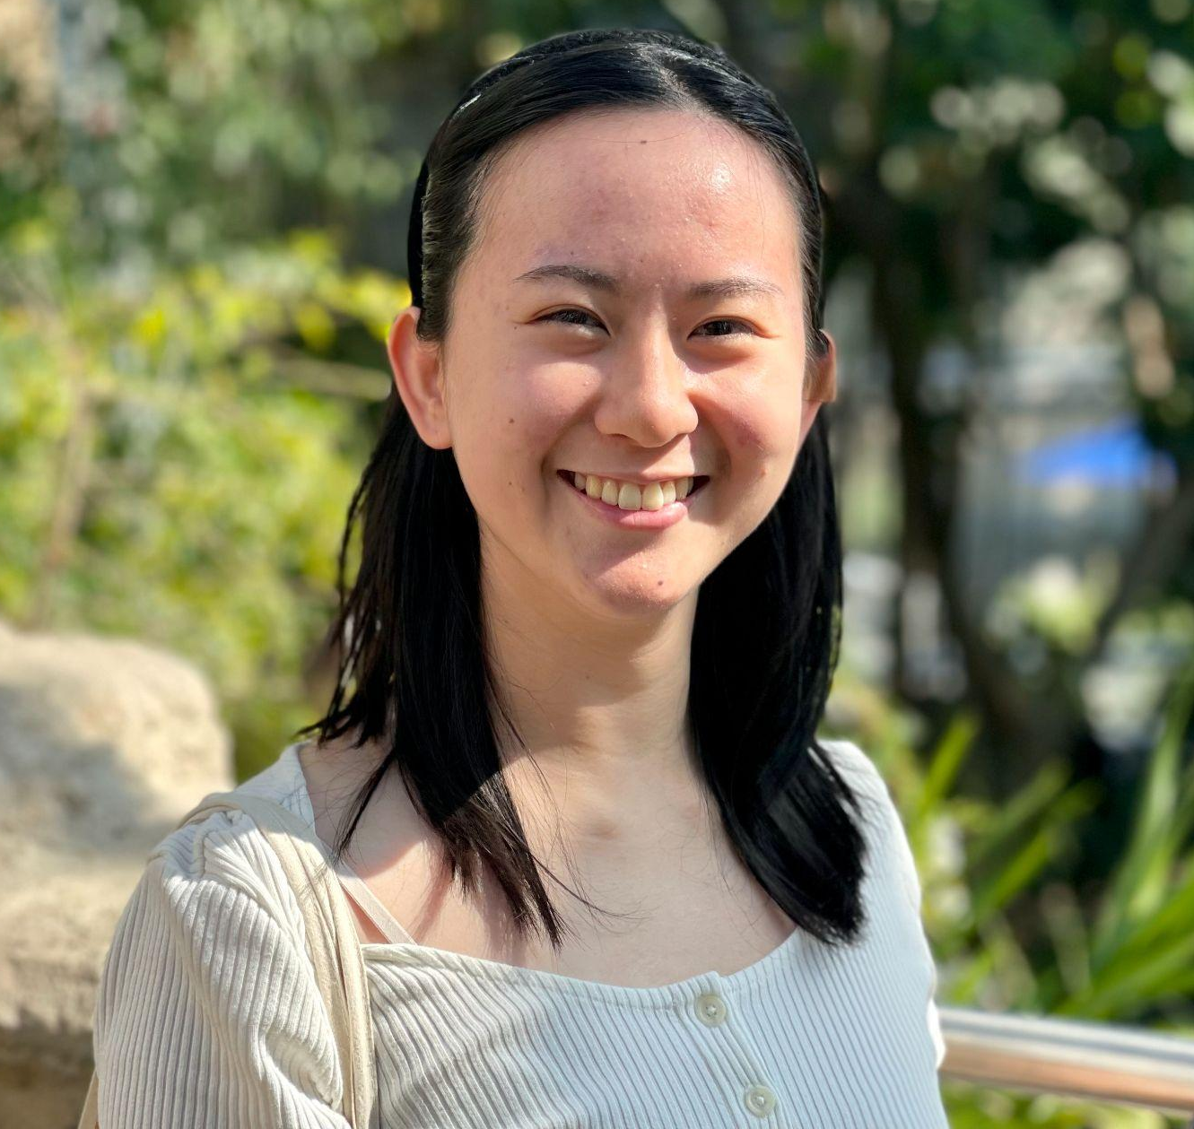
Team
Casey Nguyen
Kayla Patterson
BSCS ‘24, MSCS ‘24
California
MSCS ‘24
New Jersey
Caroline Tran
Sophie Wu
BSCS ‘23, MSCS ‘25
Washington
BSCS ‘24, MSCS ‘25
Minnesota
Notes:
My name is Caroline and I’m on a team with Casey, Kayla, and Sophie.

Slide 3
Problem Domain:
Original Problem:
Revised Problem:
How can we use music to help people preserve memories & life events?
How can we harness power of music to evoke emotions and connect with past?
Nostalgia shaping memory and identity
Emotion-based: Memory, song, sensory
Notes:
As a team, we initially felt strongly about using music as a way to help preserve the past, whether it be memories that our users want to revisit, or cultural identities that our users connected with.
“How can we harness the power of music to evoke diverse emotions, connect with past experiences, and resonate with personal identity?”
However, our problem domain tried to be two things at once, so for this week, we decided to redefine our problem domain to better fit the needs of those we interviewed.
Rather than trying to address both memory and identity individually, we switched our focus more towards emotion-based reactions to music and how we can create and foster relationships through these emotions.

Slide 4
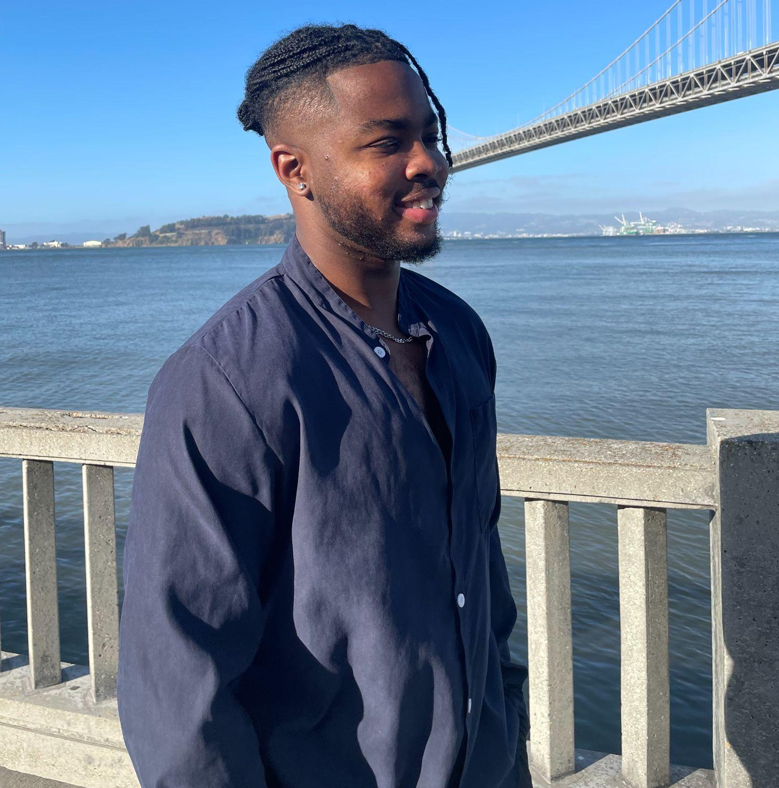
2 Additional Interviews
Follow
Like
Share
Music has the power to transport listeners.
Joseph Lambo
Software Engineer at Google, living in San Francisco
Full playlist
Notes:
Over the weekend, our team interviewed two individuals:
Joseph Lambo who is a Software Engineer at Google and has no affiliation with Stanford. We met Joseph through ___
Yifan Ding is a Data Analyst. We connected with Yifan through a reddit post and was able to meet her at a cafe in redwood city.
Music has the power of transporting → Joseph mentioned being transported to a more peaceful time with his family, a time that was void of all the stresses and bustling world he lives today.

Slide 5
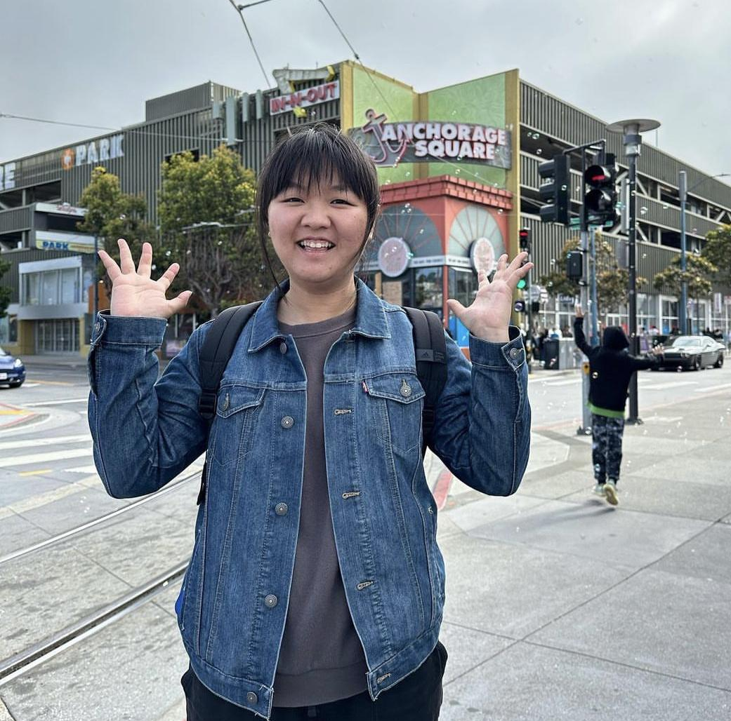
2 Additional Interviews
Follow
Like
Strong emotional connections to varied music over many years.
Share
Yifan Ding
Data Analyst from Mountain View
Full playlist
Notes:
Over the weekend, our team interviewed two individuals:
Joseph Lambo who is a Software Engineer at Google and has no affiliation with Stanford. We met Joseph through ___
Yifan Ding is a Data Analyst. We connected with Yifan through a reddit post and was able to meet her at a cafe in redwood city.
From these two interviews, we learned that:
People are more willing to listen to different genres of music than we perceived. Just by speaking with Yifan, we noticed that she listed more than ____ types of genres with artists ranging from instrumentalists to vocalists, spanning over ___ years of musical history.
When speaking with Yifan, we noticed that she loved many musical genres (K-Pop, Rap, Classical) with artists ranging from instrumentalists to vocalists. Additionally, she had strong emotional connections to many of these pieces, especially those that have accompanied over many years, and through many stages of her life. For example, when seeing her favorite pianist perform live, she recalls the feeling of being in the audience, a single spotlight on him and the piano on stage, and tearing up when she heard the first note being played.

Slide 6

Initial POVs
It would be game-changing to have a platform where Diana can listen and annotate their feelings and memories associated with specific songs or genres.
We were surprised to notice that Joseph’s memory of recollecting the “normal” times of his life with a certain song. He recollected the last time he was with his brothers back in Nigeria; they were listening to the song called “Pop Style” by Drake…he mentioned how this added weight to the memory because it was truly the last time his life was considered “normal”...
Notes:
@jhclee@stanford.edu This is our initial POVs from studio 2 but it's too lengthy so we aren't including it in the presentation. We put it here for your reference though.

Slide 7
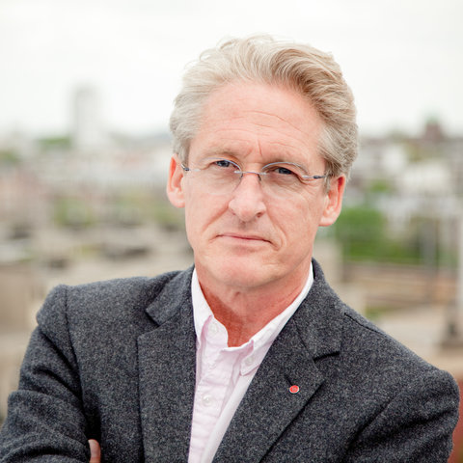
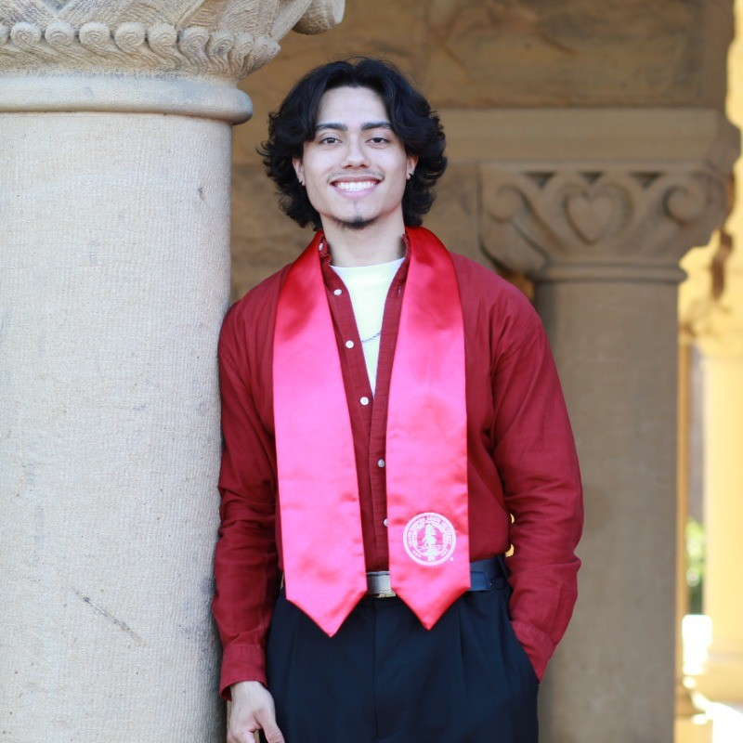
Initial POVs
It would be game-changing to tap into music’s link with personal memories for users like Michael to…alter the visual-auditory context of recalling memories, users can refine their introspection and link memory, music, and emotion.
We wonder if Yifan’s intense reaction to music reflects a deeper and continually evolving relationship to these songs that she’s carried with her for many years and through many different situations.
We wonder if Bryant perceives music as a tool that can shape social dynamics. To him, music plays a crucial role in fostering a comfortable social atmosphere and building connections.
Notes:
@jhclee@stanford.edu This is our initial POVs from studio 2 but it's too lengthy so we aren't including it in the presentation. We put it here for your reference though.

Slide 8
Revisions from Initial Studio 2 POVs
01
02
Less “solution-y”
More concise
for the game changers
when describing insights
03
More direct
when explaining complex beliefs

Slide 9
Revisions for Diana’s POV
Original:
Revised:
It would be game-changing to have a platform where Diana can listen and annotate their feelings and memories associated with specific songs or genres.
It would be game-changing for users like Diana to be able to listen and annotate their feelings and memories associated with specific songs.
Notes:
As a team, we initially felt strongly about using music as a way to help preserve the past, whether it be memories that our users want to revisit, or cultural identities that our users connected with.
However, our problem domain tried to be two things at once, so for this week, we decided to redefine our problem domain to better fit the needs of those we interviewed.
Rather than trying to address both memory and identity individually, we switched our focus more towards emotion-based reactions to music and how we can create and foster relationships through these emotions.

Slide 10
Revised POVs
Diana is a recent Stanford graduate with a background in psychology and education who is now working in an advising role. Diana frequently uses music as a “backing track” for various activities in her life.
Diana's intricate relationship between music, nostalgia, and her emotions; in particular, she expresses how certain songs evoke memories of distinct life events, such as the stress of writing college applications.
Music for Diana is more than auditory pleasure; it’s a sensory time machine, bringing her back to particular moments, feelings, and memories.
For users like Diana to be able to listen and annotate their feelings and memories associated with specific songs or genres.
Notes:
Bold main words in the POVs that differentiate/strengthen them → so the audience isn’t overwhelmed by a long POV

Slide 11
Revisions for Joseph’s POV
Original:
Revised:
We were surprised to notice that Joseph’s memory of recollecting the “normal” times of his life with a certain song. He recollected the last time…
We were surprised to notice certain songs allowed Joseph to recollect a life that is “normal” with him and his brothers back in Nigeria.
Notes:
As a team, we initially felt strongly about using music as a way to help preserve the past, whether it be memories that our users want to revisit, or cultural identities that our users connected with.
However, our problem domain tried to be two things at once, so for this week, we decided to redefine our problem domain to better fit the needs of those we interviewed.
Rather than trying to address both memory and identity individually, we switched our focus more towards emotion-based reactions to music and how we can create and foster relationships through these emotions.

Slide 12
Revised POVs
We met Joseph Lambo, a Software Engineer at Google, who lives in San Francisco but works in Mountain View. On his long commute to work he enjoys listening to music to pass the time.
We were surprised to notice certain songs allowed him to recollect a life that is “normal” with him and his brothers back in Nigeria.
We wonder if this means feeling a connection of the past with music holds a large amount of weight on that memory and reminds one of an experience that they felt was more normal than the life they currently live.
It would be game-changing if we could connect users to their past experiences through music that would allow them to reminisce and connect to the times they considered “normal”.
Notes:
Bold main words in the POVs that differentiate/strengthen them → so the audience isn’t overwhelmed by a long POV

Slide 13
Revised POVs
Joseph Lambo, a Google Software Engineer in Mountain View, commutes from San Francisco.
During his commute, certain songs remind him of a “normal” life with his brothers in Nigeria.
The connection between music and past memories seems potent.
Leveraging music to help users reconnect with cherished past moments could be transformative for users like Joseph.
Notes:
Bold main words in the POVs that differentiate/strengthen them → so the audience isn’t overwhelmed by a long POV

Slide 14
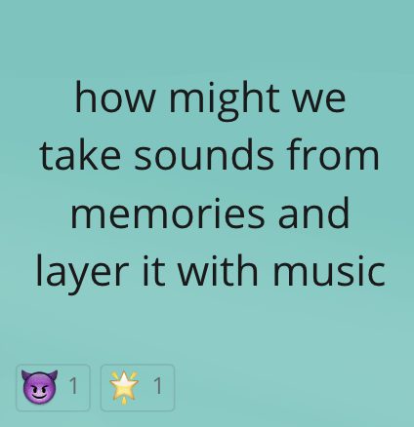
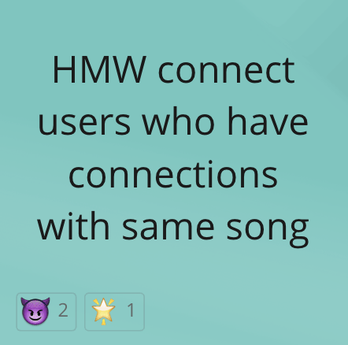
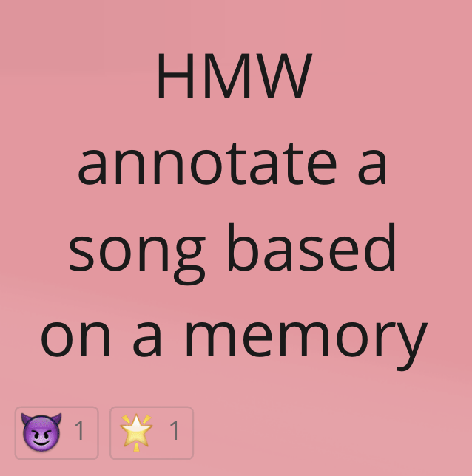

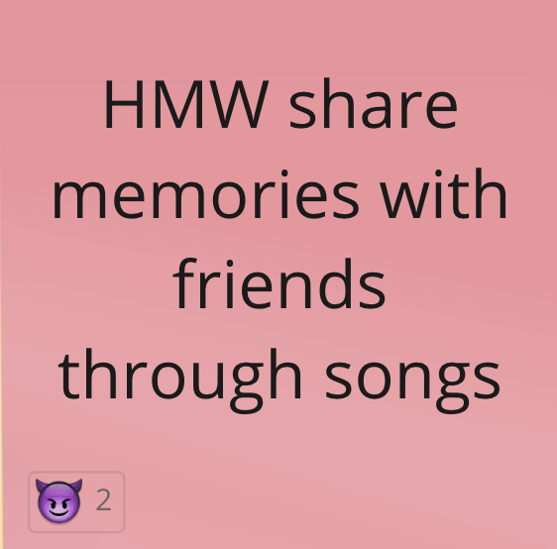
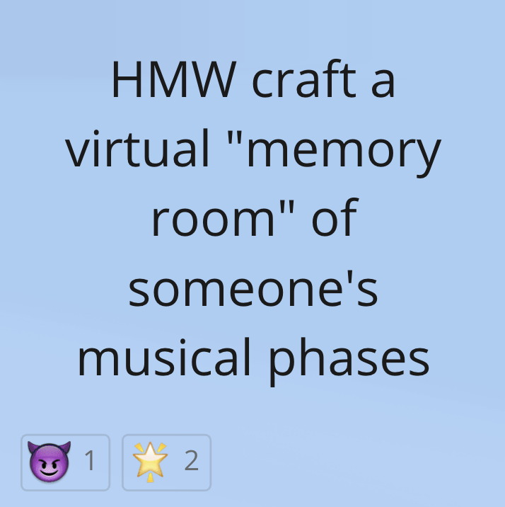
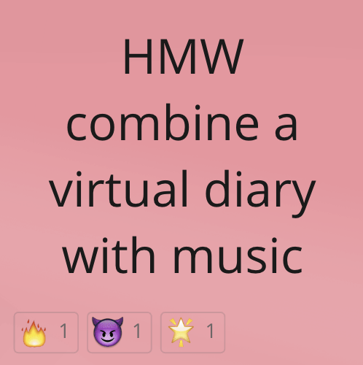
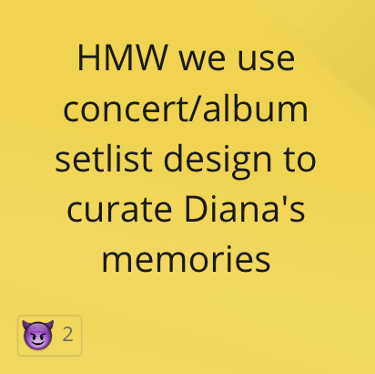
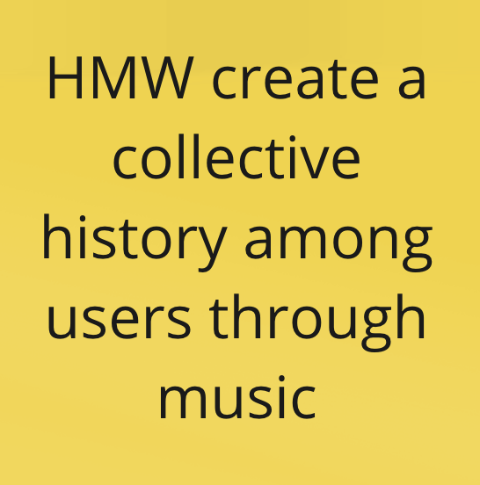
Diana’s HMW Map Highlights
Caroline
Kayla
Sophie
Casey
Notes:
Diana’s HMW Miro Board: https://miro.com/app/board/uXjVNcCr_5w=/?share_link_id=361450612271
Highlights:
Sounds from memories → laughter, leaves crinkling, wind blowing, etc
How to connect users throughout the user space
Collective history, collaborative history
Using a concert setlist to simulate a storyline
Diary entries: voice entries, journal entries
Virtual room: walkthrough of a memory

Slide 15


Diana’s Top HMW
POV
We met Diana who frequently uses music as a “backing track” for various activities…
We were surprised how she … expresses how certain songs evoke memories of distinct life events…
We wonder if music is more than auditory pleasure; it’s a sensory time machine….
It would be game-changing to users like Diana to be able to listen and annotate their feelings and memories associated with specific songs or genres.
HMW use concert/album setlist design to curate Diana’s memories?
HMW create a collective history with friends through songs?
HMW craft a virtual "memory room" of someone's musical phases/personal history?
Notes:
Bold main words in the POVs that differentiate/strengthen them → so the audience isn’t overwhelmed by a long POV

Slide 16
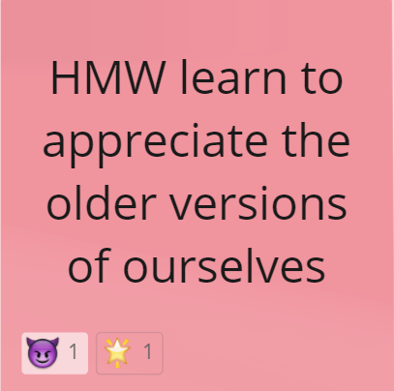
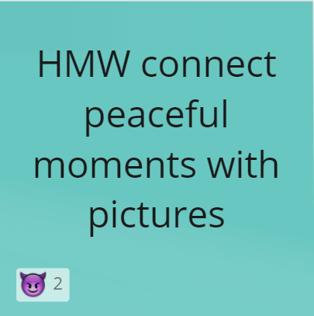
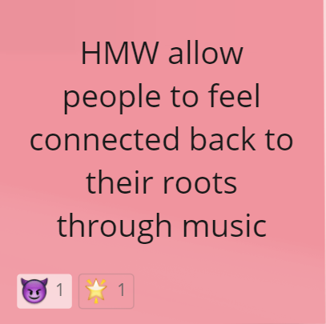
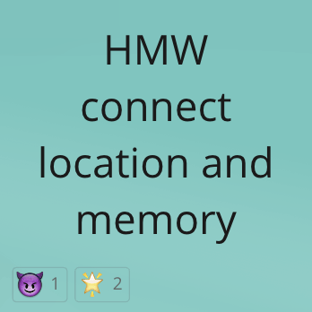
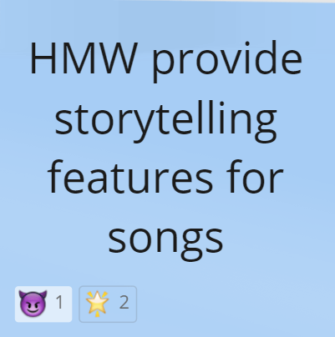
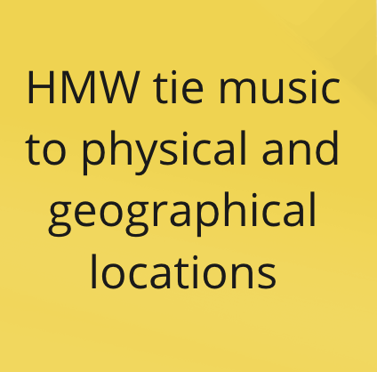
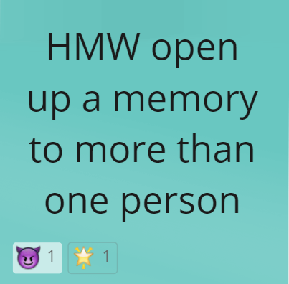
Joseph’s HMW Map Highlights
Caroline
Kayla
Sophie
Casey
Notes:
Joseph’s HMW Miro Board: https://miro.com/app/board/uXjVNcCr_Uw=/?share_link_id=733080200040
Main highlights:
Location and memory, geographical locations and music
Older versions of ourselves → looking into the past, reconnecting with our roots
Storytelling features

Slide 17
Joseph’s Top HMW
POV
We met Joseph Lambo…who on his long commute to work he enjoys listening to music to pass the time.
We were surprised to notice some songs made him nostalgic of a “peaceful” life with his brothers in Nigeria.
We wonder if … music intensifies the impact of memories, evoking times that felt more 'normal' than one's current life.
It would be game-changing if we could connect users to their past through music to reminisce and connect to “normal” times.
HMW provide a storytelling feature for songs?
HMW minimize the stresses of the present/provide escapism/detach from reality?
HMW connect users with similar music tastes to each other’s life “normals” and experiences?

Slide 18

Solution 1: Reprise
Reprise:
Platform for people to stop what they are doing and share a song!
Critical Assumption:
People listen to music for the majority of the day
People are comfortable sharing their music choices

Slide 19
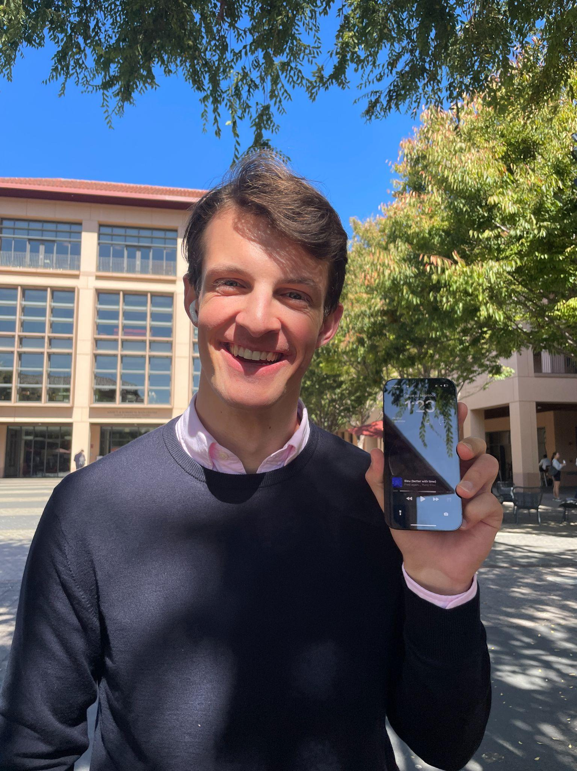
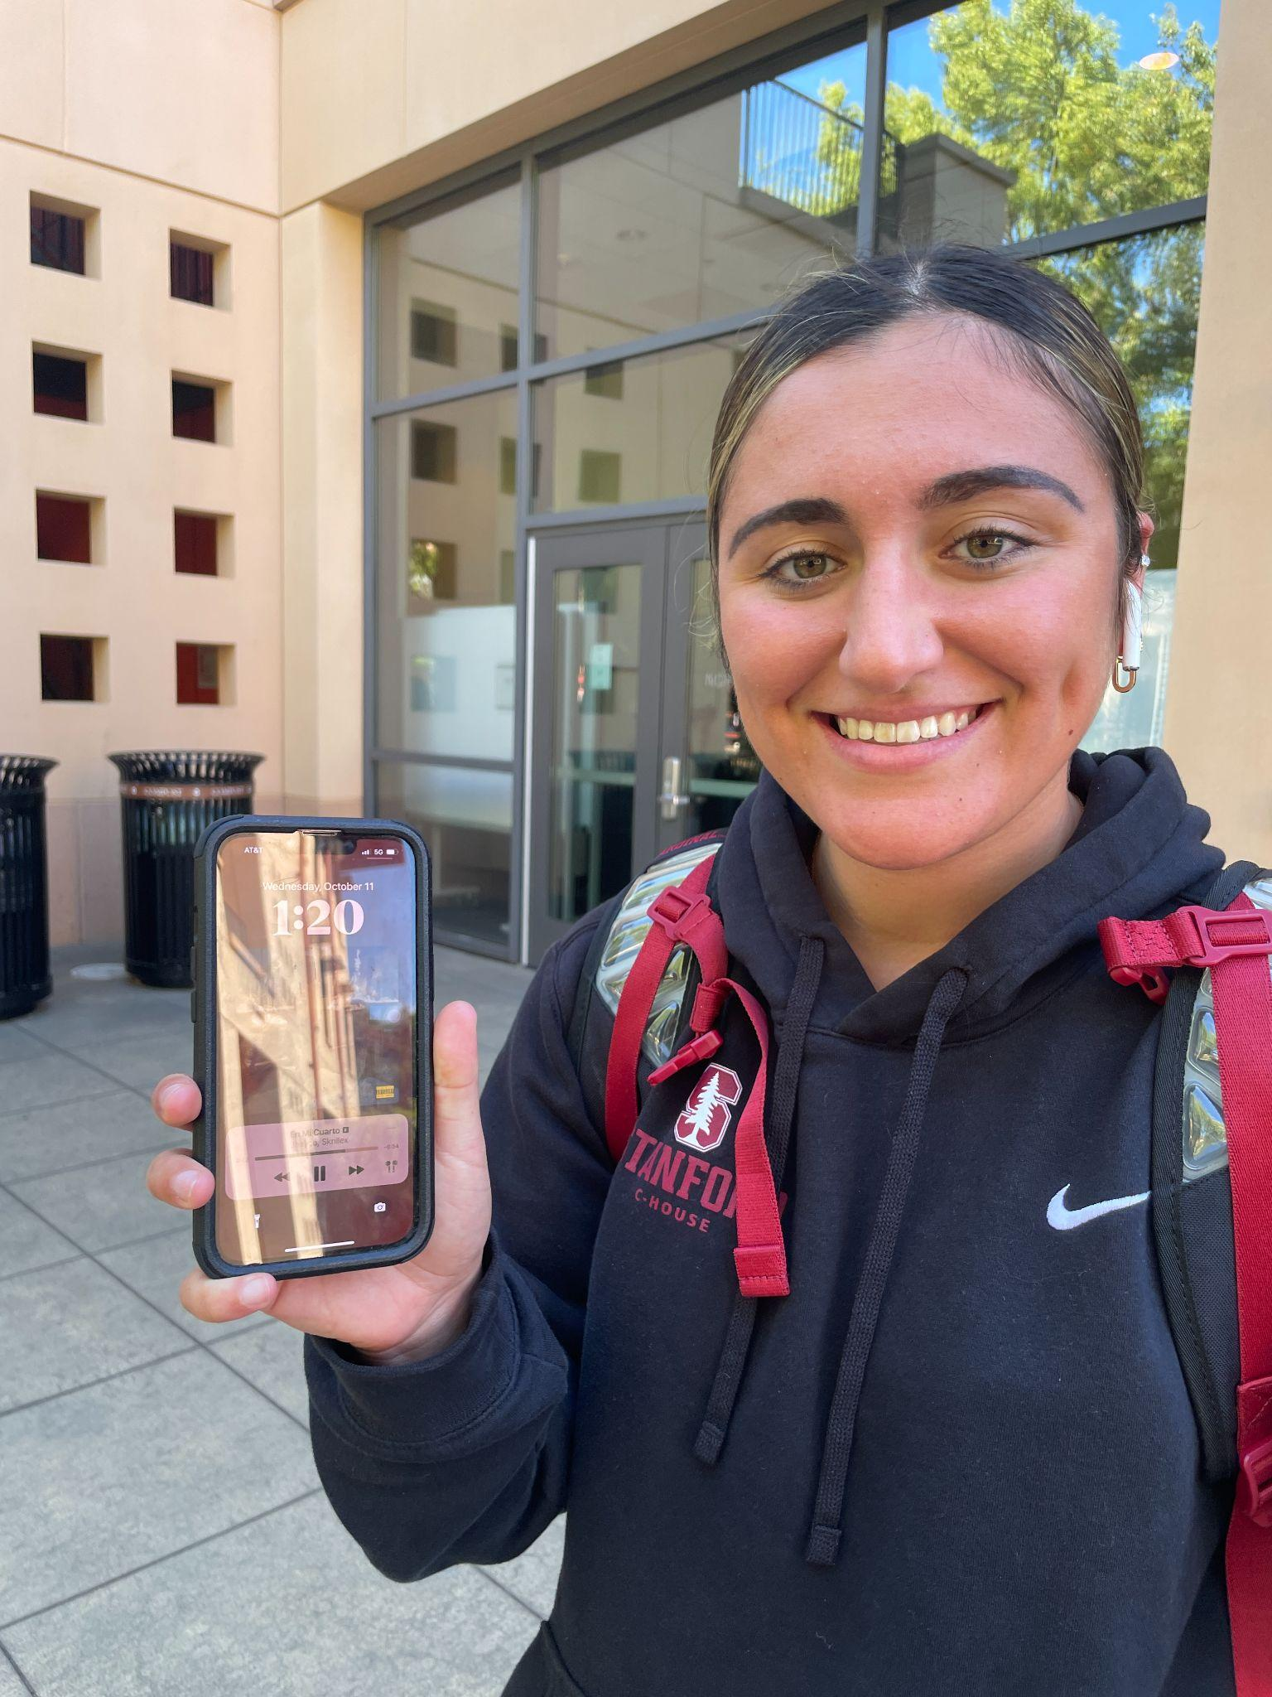
Reprise Prototype:
“Hi! What are you listening to?”
Bleu (better with time)
Fred again…
En Mi Cuarto
Jhayco, Skrillex
Notes:
Prototype method:
Initially we walked up to people to ask about their memories etc
Challenge: memories are personal, and memorable songs are also personal. It’s hard to open up to total strangers so many were reluctant to share.
Solution: we decided to restructure the prototype to include anonymity through a google form → we tested the same critical assumption but with a middle man instead
Went up to random people around different parts of campus (Med School, Book Store, GSB)
Asked questions
What song they were listening to?
Did they want to hear what the last person was listening to and their thoughts on it?
Collected data in excel sheet

Slide 20

Reprise Findings:
Results
Majority shared songs
All listened to new songs
Podcasts + news too
Analysis
People are curious!
Music is not as private as we thought.
“Cool beat”
“Got a nice beat”
“Sounds powerful”
“It’s not really what I listen to but I don’t like it or dislike it.”
Notes:
Analysis
People are curious about the songs people listen too
Sharing music with others invites a conversation
People like to share their music to anyone
Music is not as hidden as we thought
Music is similar to a type language that people want to share and experience

Slide 21



Solution 2: SoundByte Memories
SoundByte Memories:
Layer songs/sound with memories, enhanced with multimedia elements.
Critical Assumption:
Digital memory revisiting is common.
Notes:
SoundByte Memories:
Platform to layer songs/sounds with memories, enhanced with multimedia elements.
Assumptions:
Memories often link to songs/sounds.
Digital memory revisiting is common.
Users may share memory-song pairings.
Multimedia adds value to memories.

Slide 22


SoundByte Memories Prototype:
Original Method:
Too personal to share with strangers.
Revised Method:
Survey on song-memory
Measure memory recording.
Do songs trigger memories?
Test sharing comfort
Notes:
Prototype method:
Initially we walked up to people to ask about their memories etc
Challenge: memories are personal, and memorable songs are also personal. It’s hard to open up to total strangers so many were reluctant to share.
Solution: we decided to restructure the prototype to include anonymity through a google form → we tested the same critical assumption but with a middle man instead
Revised Method:
Survey on song-memory ties.
Measure digital memory engagement.
Test song evoking memories.
Assess sharing comfort levels.
Survey posted on Casey’s instagram story, SVSA + Ng Slack, r/music and r/takemysurvey subreddits
Switched from walking up to people to online survey

Slide 23

SoundByte Memories Findings:
Results
Link to memories
Varied emotions
Cultural context
Analysis:
Emotional bookmarks
Many memories
aren't recorded
“Last Christmas....
I had my heartbroken”
“Get Gone…I listened to it …on repeat (5 hours) after my mom told me some bad news.”
Notes:
Results
Majority link songs to personal memories.
Music evokes diverse emotions: happiness to trauma.
Multiple languages & cultural contexts noted.
Personal and communal bonds formed through shared music.
Many significant memories aren't digitally captured.
Analysis
Music serves as emotional bookmarks.
Songs bridge diverse cultural identities.
Immediate and lasting impact of musical associations.
Cherished moments often remain undocumented but alive through music.

Slide 24

Geo-Anchored Memory Capsule Prototype:
Solution:
Geo-tag songs & memories to real-world locations
Assumptions:
Users often visit
varied public spaces.

Slide 25

Geo-Anchored Memory Capsule Prototype:
Prototype Method:
Engage users at a location about current song.
Share past user song & memory with new entrants.
Survey on song-location associations.

Slide 26
SoundByte Memories Findings:
Results
Link to memories
Varied emotions
Cultural context
Analysis:
Emotional bookmarks
Many memories
aren't recorded
“Last Christmas....
I had my heartbroken”
“Get Gone…I listened to it …on repeat (5 hours) after my mom told me some bad news.”
Notes:
Results
Majority link songs to specific locations or moments.
Memories range from broad locations (e.g., Indonesia) to specific spots (e.g., childhood bedroom).
Diverse emotions evoked, from nostalgia to empowerment.
Cultural and travel experiences influence associations.
Analysis
Music powerfully anchors memories, validating the geo-capsule concept.
Diversity in location types suggests flexibility in capsule creation.
Emotional context enriches the song-location bond.
Potential for users to discover songs based on cultural or travel contexts.

Slide 27
The winner is… Reprise!
Add features from others:
Memory-Song Association:
  Attach personal stories to songs.
Location-Based Playback:
  Relive songs in meaningful places.
Nostalgia Playlists:
  Auto-curated based on past memories.
Shared Experiences:
  Connect with friends over music memories.
Notes:
Add features from others:
Memory Song Association:
Attach personal stories to songs.
Location-Based Playback:
Relive songs in meaningful places.
Nostalgia Playlists:
Auto-curated based on past memories.
Shared Experiences:
Connect with friends over music memories.

Slide 28
Ethical implications?
Content Moderation
Privacy
Tech Dependency
How will hateful or inappropriate content be controlled?
How will privacy be handled when users are attaching photos and locations to their liked music?
How will an app like this impact screen time, tech usage, and real-world social interactions based on music sharing?
Notes:
Ethical implications:
Censorship → would not be able to scan for expletives since this is an on-the-spot type of approach
Music suggestions would not be filterable easily
Might also increase screen time → would mean more usage on our app, but this could also mean too much time on it ?

Slide 29
Who does it serve? Who does it not?
Does
1 | Those interested in new music
2 | Those interested in random music exchange
3 | Those willing to share their own music
4 | Those who like documenting their lives
Does Not
1 | Those who can’t/don’t use phones
2 | Those who don’t listen to music
3 | Those not willing to share personal tastes
4 | Those without convenient access to music or Wi-Fi
Notes:
Who does it serve:
People interested in learning new songs/music pieces
People who are willing to share their music choices
Who might it leave out:
People who don’t use their phones often
People who don’t listen to music often → lots of people were listening to podcasts
People who use music streaming services

Slide 30
APPENDIX:
Additional artifacts from Yifan’s interview
Additional artifacts from a third (optional) interview, Michael Prosinski
Miro board containing all of the HMW for Diana: https://miro.com/app/board/uXjVNcCr_5w=/?share_link_id=361450612271
Miro board containing all of the HMW for Joseph: https://miro.com/app/board/uXjVNcCr_Uw=/?share_link_id=599444880505
POV Brainstorming
HMW Brainstorming
Solutions Brainstorming

